Slide 1
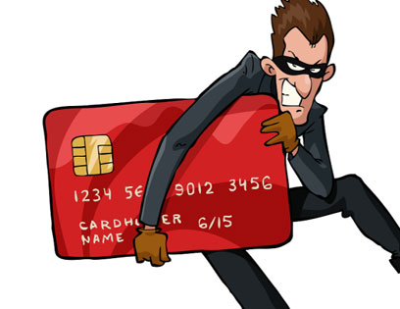
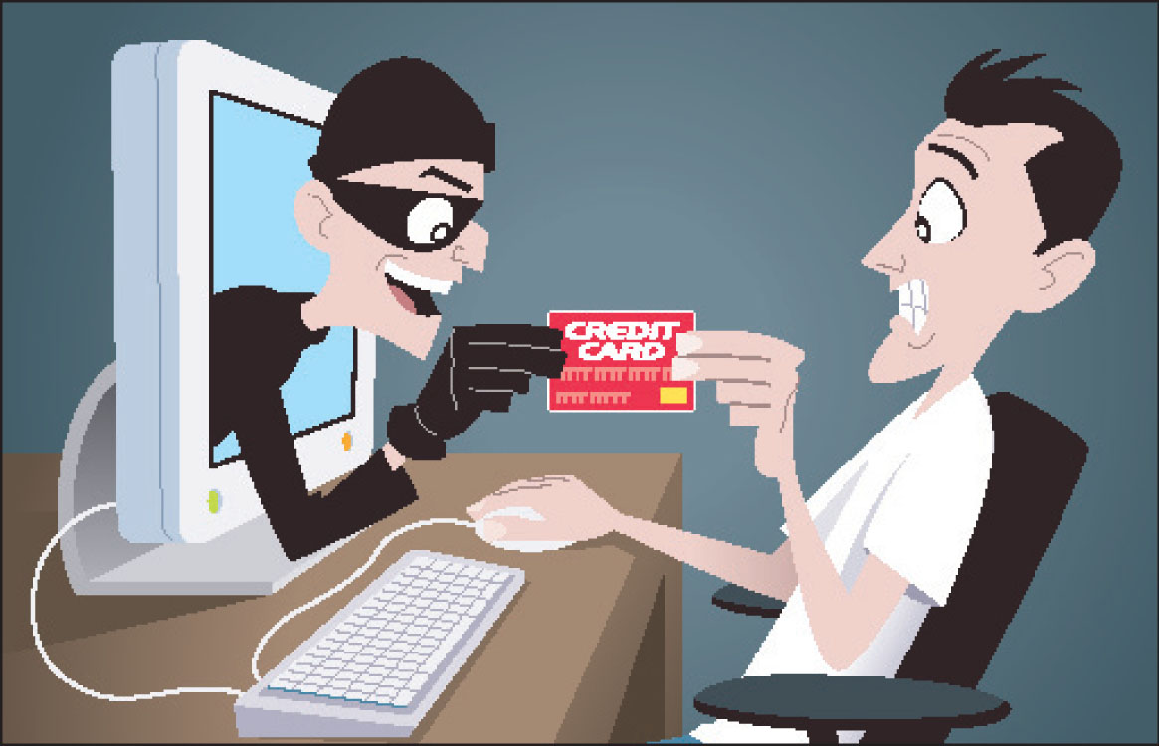

CREDIT CARD FRAUD DETECTION
Submitted By:
Suzanna Michelle Young
Deepak R
Varsha B S

Slide 2






BACKGRAOUND OF PROBLEM
Huge revenue loss due to unauthorised transactions during non-peak and odd hours of the day.
Source: Stolen/lost cards, ATM skimming at various POS terminals.
Stopping the fraudsters/fraudulent activity is highly impossible as they actively find alternate ways.
Extra level authentication is complex & tedious job.
Goal is to detect and prevent the fraudulent transactions before the financial crisis.

Slide 3
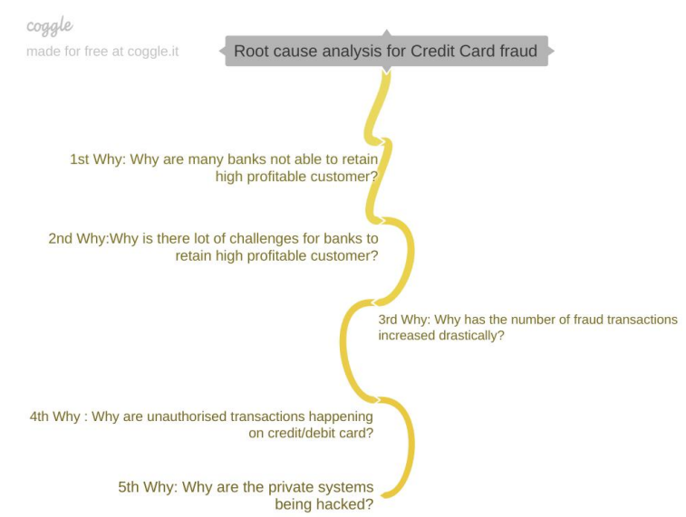


ROUTE CAUSE ANALYSIS
5 WHYs
Sensitive credit card details of customers is being accessed.
Private systems are hacked, stolen/lost cards are misused, ATM skimming at POS terminals.

Slide 4


UNDERSTANDING THE PROBLEM & IMPACT
Who is involved in the process?
Fraudsters, skimmers who get unauthorized access to a customer’s credit card info.
What do they do with it?
Commit fraudulent transactions: alter genuine cards, create counterfeit cards, steal credit cards, fraudulent telemarketing.
Where do the transactions happen?
Most of them happen online and sometimes offline.
Online frauds are hard to detect due to difficulty in amassing evidence, time & resource constraints.
When does it happen?
Most happen at non-peak and odd hours of the day when user in-active or asleep.
How is business affected by this?
As bank need to repay customer the total transaction amount in case of fraudulent transaction
Banks suffer from substantial financial loss, lose trust & customer’s credibility.

Slide 5


PROCESS FLOW
Data Import
&
EDA on Train Data
Data
Cleaning
Selecting Feature with significant impact
Train, Test
Split
Build models with various techniques
Cost Benefit analysis
Validate model with Recall & AUC
Model Fitting
on Test/unseen Data
Compare model performance & chose the best
Validate model with Recall & AUC

Slide 6
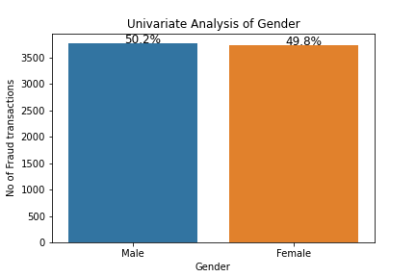
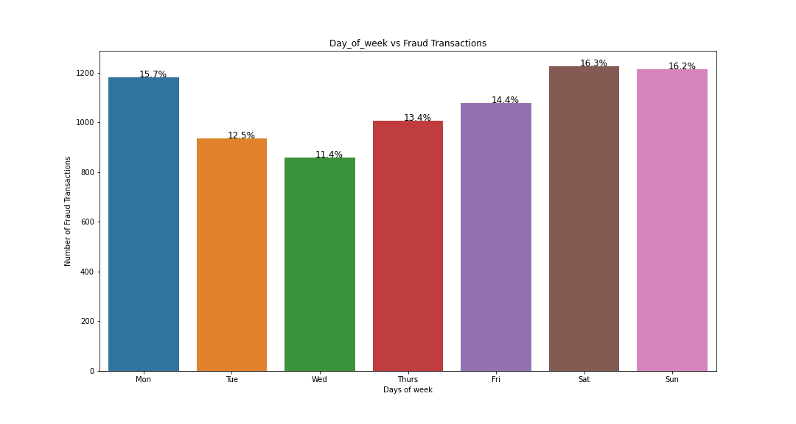
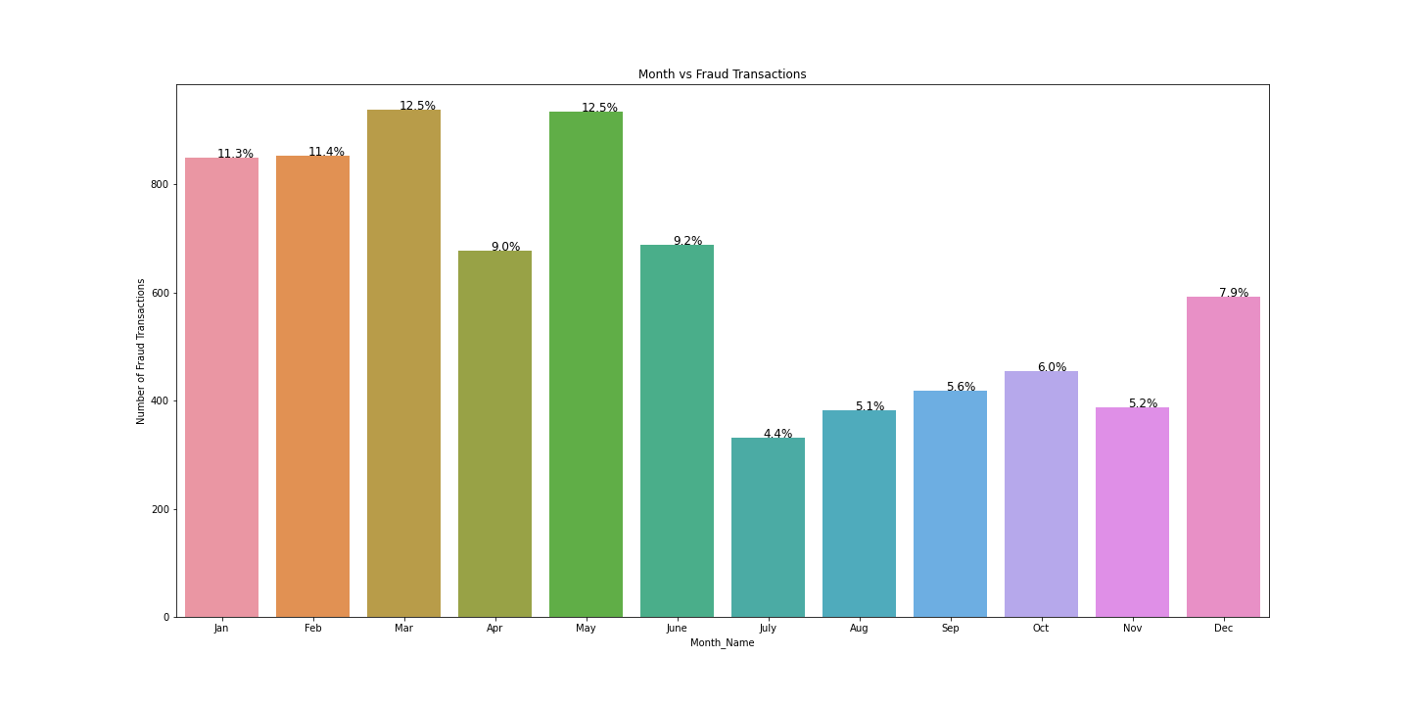
CHARACTERISTICS OF FRAUDULENT TRANSACTIONS
Gender v/s fraudulent transactions
Day of the week v/s fraudulent transactions
Month v/s fraudulent transactions

Slide 7
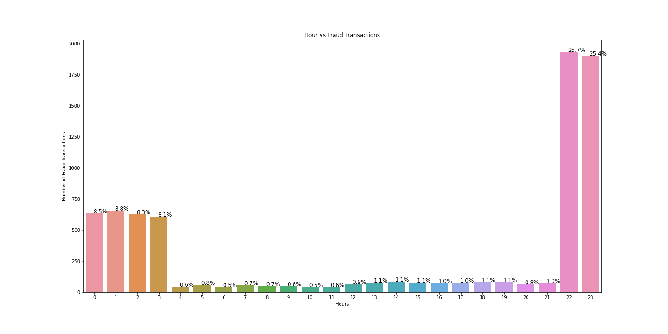
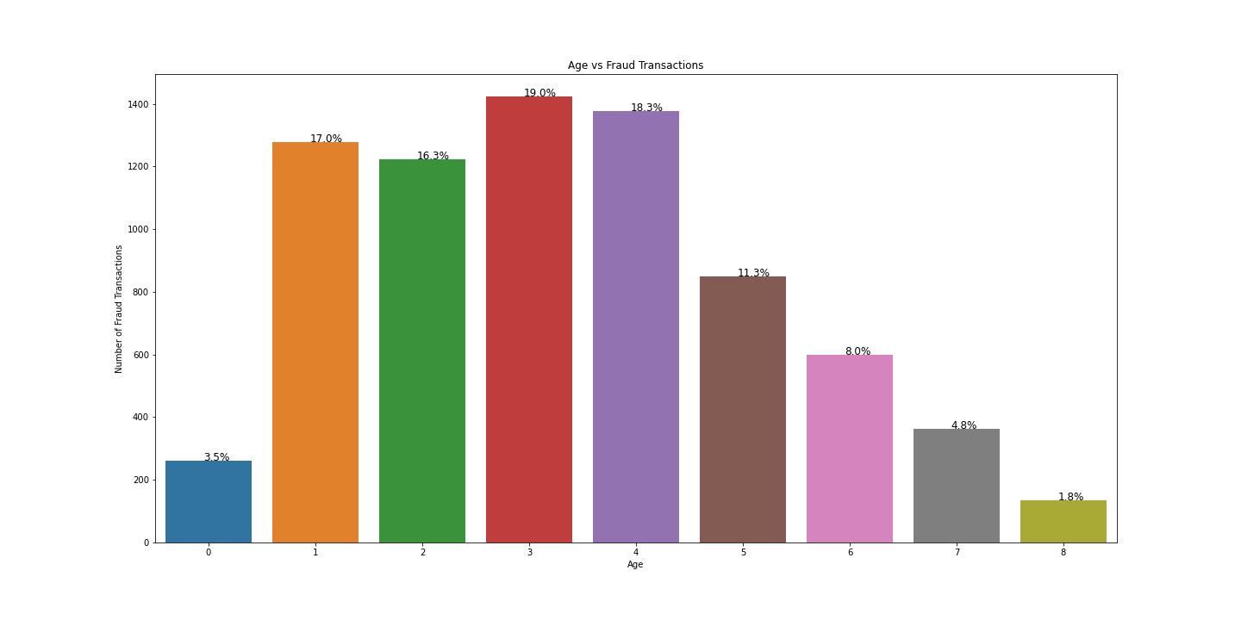
CHARACTERISTICS OF FRAUDULENT TRANSACTIONS
Hours of day v/s transactions
Age v/s fraudulent transactions

Slide 8
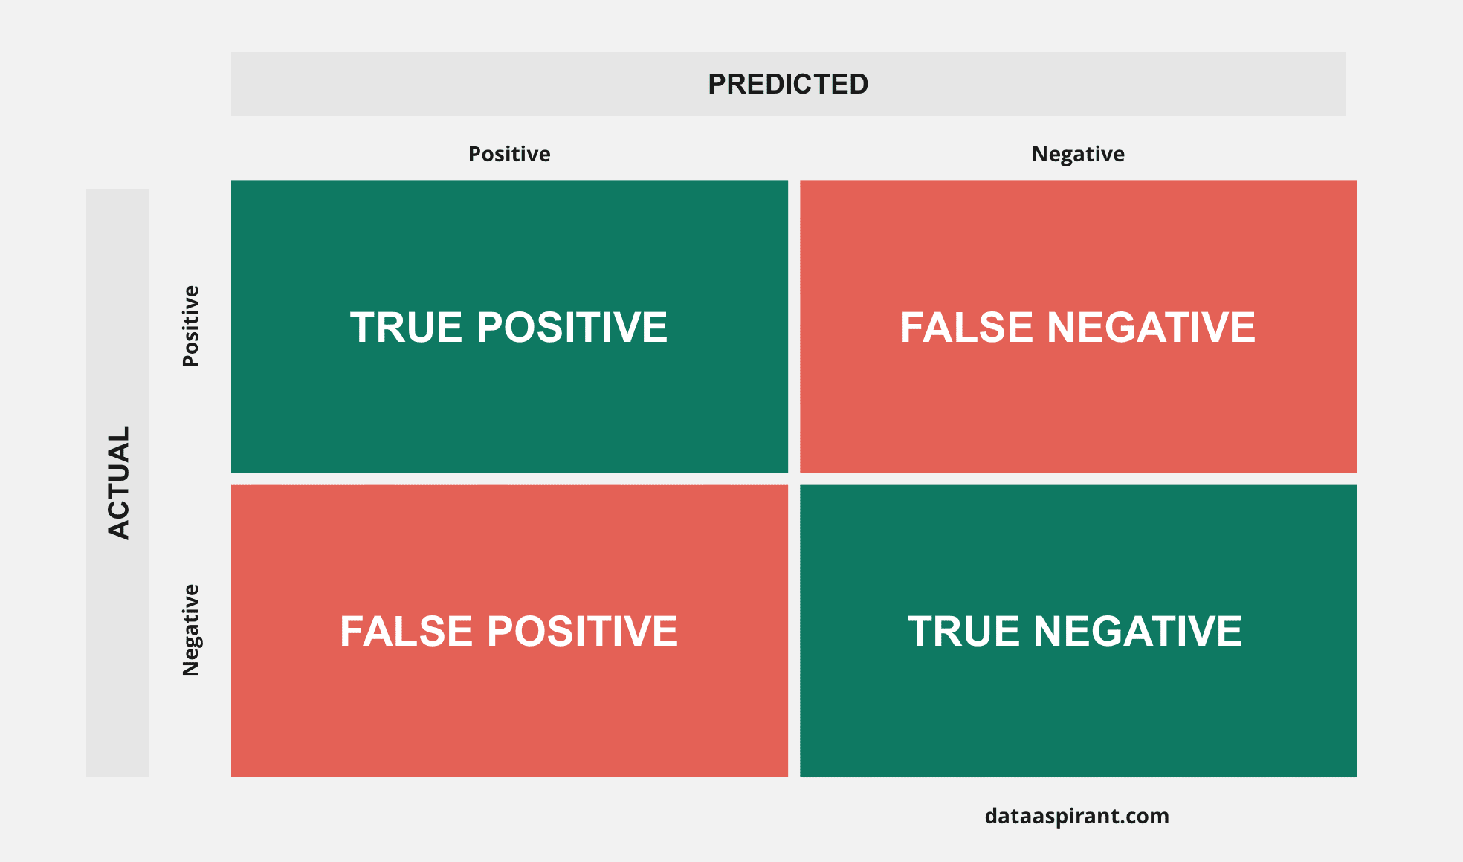
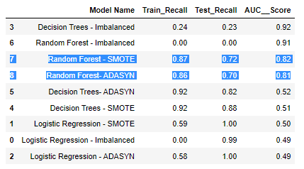
MODEL PERFORMANCE ON TRAINING DATA
Evaluation metrics: Recall, AUC
Why Recall?
Most likely to predict actual Positive cases(Fraud transactions).
Very helpful to reduce financial loss.
Recall = TP / (TP + FN)
High Recall refers to low false negative score.
Why AUC?
Best to measure overall performance of a binary classification problem.
Best to select optimal threshold value of a model.
Plots TPR v/s FPR.

Slide 9
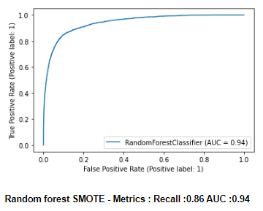

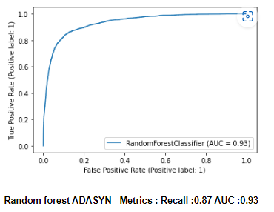
MODEL PERFORMANCE ON TEST/UNSEEN DATA
Trade off b/w Random Forest SMOTE & Random Forest ADASYN.
Still choose Random Forest ADASYN why?
Impact from 1% increase in Recall score.
1% of overall transaction = 18,524 (Train+Test)
Assumption: Financial impact of 1% fraud in 1% of overall transaction
1% of Fraudulent transactions = 0.01% overall transaction = 185 transactions.
Avg amt for 185 transaction = (avg amount/transaction) * $185 = $98,050

Slide 10



COST BENEFIT ANALYSIS

Slide 11


